Slide 1

San Francisco Crime Data
By: Caroline Amalie Fuglsang-Damgaard
Notes:
Add date and background image of city

Slide 2
Presentation of Dataset

Slide 3
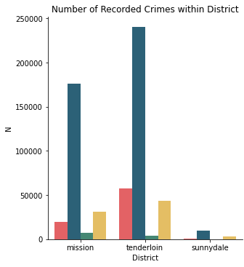
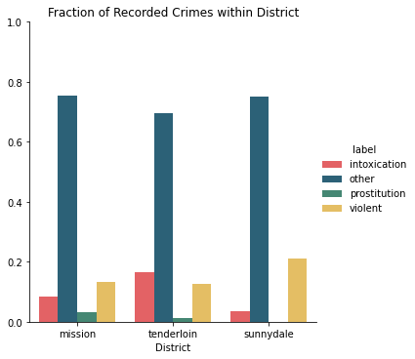
Kriminalitet fordelt på distrikter
Distrikt | Mission | Tenderloin | Sunnydale
N | 234.316 | 345.421 | 13.111

Slide 4
Crime vs. Time

Slide 5
Violent crime throughout the week

Slide 6
Modelling risk of violent crime
Assumptions
Police officers need to be more alert when handling violent crime
The three districts have an interest in allocating their resources to better handle violent crime
Violent crime is important to handle because people are afraid of violence
Knowing something about the risk of violent crime can help to
Allocate more officers to deal with potentially violent situations
Better prepare the officers for the situation they are about to handle

Slide 7
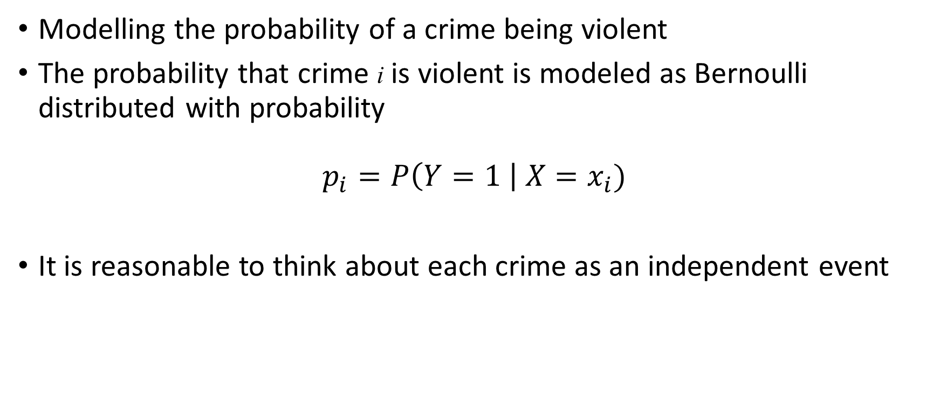
Logistic Regression
Modelling the probability of a crime being violent
The probability that crime i is violent is modeled as Bernoulli distributed with probability
$$p_{i}=P\left(Y=1 \right| X=x_{i})$$
It is reasonable to think about each crime as an independent event
Notes:
Starter med ikke at bruge valideringsættet. Dette kunne jeg f.eks. have brugt til at tune regulariseringsstyrker eller typer af regularisering. Det kunne være en ide at bruge grid search, hvis man virkelig gik op i, hvordan modellen perfomer.
Tanker om performance: Høj accuracy fordi target-variablen er imbalanceret. Måske en god idé at kigge på noget calibration af classifieren, eller undersøge, om man måske skulle have et cut-off, der var lavere end 50%. Når jeg bare inspicere prædiktionerne er der nogle af de observationer med is_violent=1, der har højere prædikteret sandsynlighed.

Slide 8
Neural Network
Parameter | Domain
n layers | {2, 3}
n hidden units | {5, 10}
learning rate | {1e-4, 1e-3}
Dropout | {0.0, 0.2}
Flexible non-linear model predicting the risk of a crime being violent
Fitting neural networks using Optuna
Binary Cross Entropy Loss Function
Optimized using validation loss
Notes:
Enkelt netværk: 2 lag m. hhv. 3 og 6 hidden units. LR = 0.0001, dropout = 0.2

